Slide 1


Nicholas Ang
21 November, 2024

Slide 2

Outline
Executive Summary
Introduction
Methodology
Results
Conclusion
Appendix

Slide 3
Executive Summary
Summary of methodologies
Data collection
Data wrangling
EDA with Data Visualization
EDA with SQL
Building an interactive map using Folium
Building a summative Dashboard using Plotly Dash
Predictive Analysis (Classification)
Summary of all results
EDA results
Interactive Analytics
Predictive Analysis

Slide 4
Introduction
Project background
Using methodologies from data science to help SpaceY make effective choices when sending rockets into space. SpaceX is currently the well-known company in space as they had managed to figure out how to send rockets into space. It is reported that it costs around 62million USD to launch their Falcon 9 rocket. SpaceX is able to save costs by reusing the first part of the rocket which potentially would cost an extra 15 million USD if it is newly purchased.
Business Problem to solve
Predict if the first part of the rocket is going to land back safely or not. Accurate prediction of this specific problem could lead to huge savings on material costs for the company which every investor would like to see.

Slide 5

Section 1

Slide 6
Methodology
Executive Summary
Data collection methodology:
SpaceX Open-Source REST API
Web Scraping from Wikipedia
Perform data wrangling
Dropping columns that were unnecessary
One Hot Encoding for machine learning algorithms
Perform exploratory data analysis (EDA) using visualization and SQL
Perform interactive visual analytics using Folium and Plotly Dash
Perform predictive analysis using classification models
How to build, tune and evaluate classification models

Slide 7
Data Collection
Datasets were collected via 2 means
Request to SpaceX REST API
Web Scraping via Wikipedia page

Slide 8
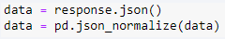
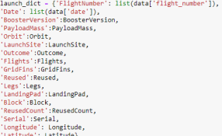
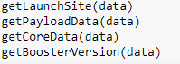
Data Collection – SpaceX API
1. Getting a Response from SpaceX API
5. Create dataframe
4. Create dictionary with data
6. Filter the dataframe
2. Convert Response into JSON file
7. Export to file
3. Transform the data

Slide 9
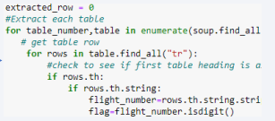
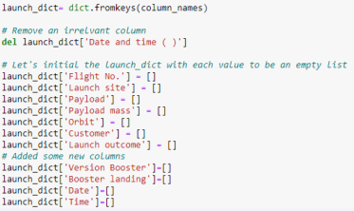
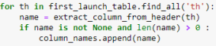
Data Collection - Scraping
1. Getting a Response from HTML
6. Add data to keys
5. Create a dictionary
2. Create BeautifulSoup Object
7. Create dataframe from dictionary
3. Find all tables
8. Export to file
4. Get names of columns

Slide 10
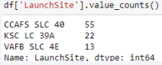
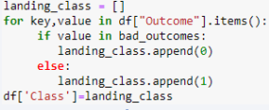
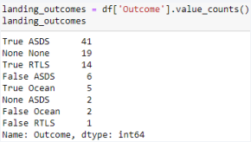
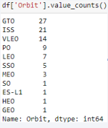
Data Wrangling
In the dataset, there were cases where the booster did not land successfully.
There is a need to transform string variables into categorical variables where 1 means the mission is successful and 0 means the mission is a failure.
1. Calculate launches number for each site
4. Create landing outcome label from outcome column
3. Calculate the number and occurrences of mission outcome per orbit type
2. Calculate the number and occurrences of each orbit
5. Export to file format

Slide 11
EDA with Data Visualization
Scatter Graphs
Flight number against Payload Mass
Flight number against Launch site
Payload mass against Launch site
Orbit against Flight Number
Payload mass against Orbit
Orbit against Payload mass
Scatter plot is used to show the relationship between variables known as correlation
Bar Graph
Success rate vs Orbit
Bar graphs show the relationship between numeric and categorical variables
Line Graph
Success Rate vs Year
Line Graph show data variables and the trends. Line graphs can help to show global behavior and make predictions for unseen data

Slide 12
EDA with SQL
SQL queries were performed to gather and understand data from this dataset:
Displayed the names of the unique launch sites in the space mission
Displayed 5 records where launch sites began with “CCA”
Displayed the total payload mass carried by boosters launched by NASA
Displayed average payload mass carried by booster version F9 v1.1
List the date when the first successful landing outcome in ground pad
List names of boosters which have success in drone ship and have a payload mass of > 4000 and < 6000
List total number of successful and failure mission outcomes
List the names of booster versions which have carried the maximum payload mass
List records with months, failure landing outcomes in drone ship, booster versions, launch site for the year 2015
Ranking of the count of successful landing outcomes between 04-06-2010 and 20-03-2017 in descending order.

Slide 13
Build an Interactive Map with Folium
Folium map object is a map centered on the NASA Johnson Space Center at Houson, Texas
Red circle at NASA Johnson Space Center’s coordinates with a label showing its name (folium.Circle, folium.map.Marker)
Red circles at each launch site coordinates with the labels showing respective launch site names (folium.Circle, folium.map.Marker, folium.features.Divlcon)
The grouping of points in a cluster to display multiple and different information for the same coordinates (folium.plugins.MarkerCluster)
Markers to show successful and unsuccessful landings. Green for successful landing and Red for unsuccessful landings. (folium.map.Marker, folium.Icon)
These objects were created in order to better understand the problem and data. From this, we can show all launch sites, their surroundings and the number of successful and unsuccessful landings.

Slide 14
Build a Dashboard with Plotly Dash
Dashboard has dropdown, pie chart, rangeslider and scatter plot components
Dropdown allows the user to choose the launch site or all launch sites (dash_core_components.Dropdown)
Pie chart shows the total success and total failure for the launch site chosen with the dropdown component (plotly.express.pie)
Rangeslider allows a user to select a payload mass in a fixed range (dash_core_components.RangeSlider)
Scatter plot chart shows the relationship between two variables, particularly Success vs Payload Mass (plotly.express.scatter)

Slide 15
Predictive Analysis (Classification)
Data Preparation
Load the dataset
Normalize data
Split data into training and test sets
Model Preparation
Selection of machine learning algorithm
Set parameters for each algorithm to GridSearchCV
Training GridSearchModel models with training dataset
Model Evaluation
Get the best hyperparameters for each type of model
Compute accuracy for each model with test dataset
Plot Confusion Matrix
Model Comparison
Comparison of models according to their accuracy levels
The model with the best accuracy rate will be chosen.

Slide 16
Results
LR, SVM, KNN are the top performing models to forecast outcomes in this data.
Lighter payloads have a higher performance compared to heavier payloads.
Likelihood of a SpaceX launch succeeding increases with the number of years of experience, potentially suggesting a trend towards flawless launches over time.
Launch Complex 39A at Kennedy Space Center has the higher number of successful launches compared to the other launch sites.
GEO, HEO, SSO, ES L1 orbit types shows the highest rates of successful launches.

Slide 17

Section 2

Slide 18
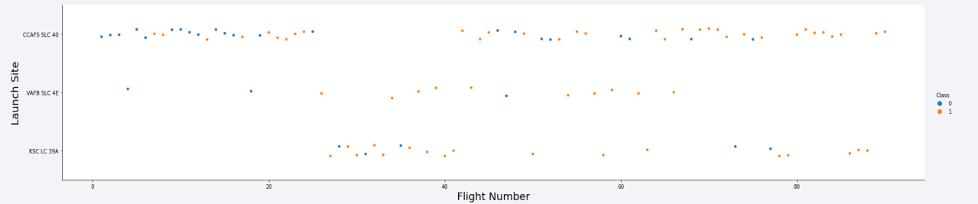
Flight Number vs. Launch Site
From the scatterplot, we can tell that the success rate is increasing for each launch site.

Slide 19
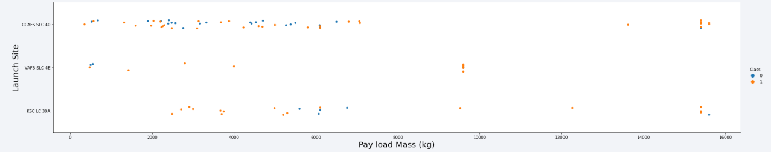
Payload vs. Launch Site
We can potentially infer that a too heavy payload can make a landing fail.

Slide 20
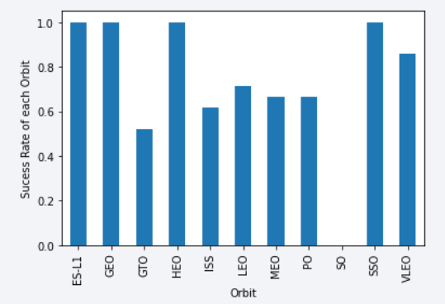
Success Rate vs. Orbit Type
We can infer that the ES-L1, GEO, HEO and SSO have the highest success rates.

Slide 21
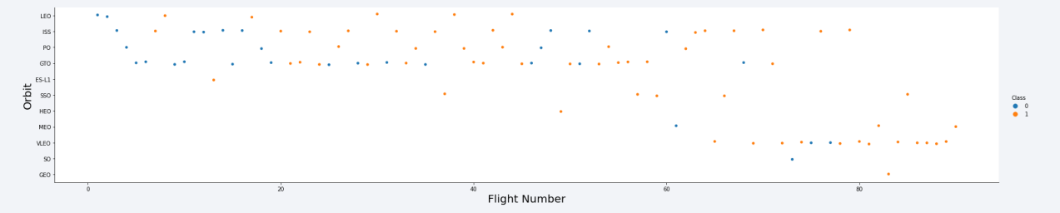
Flight Number vs. Orbit Type
We can infer that LEO, ISS, PO and GTO orbits have the most launches in the earlier years but it has slowly shifted to VLEO orbit in the later years.

Slide 22
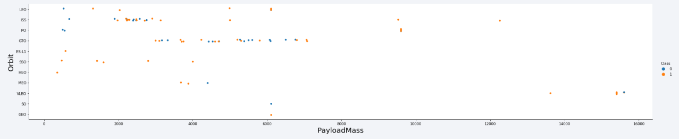
Payload vs. Orbit Type
We can infer that the weight of the payload potentially have a great influence on the success rate of the launches in certain orbits.
For example, heavier payloads improve the success rate for the LEO orbit. Another finding is that by decreasing the payload for a GTO orbit, it improves the chances of a successful launch.

Slide 23
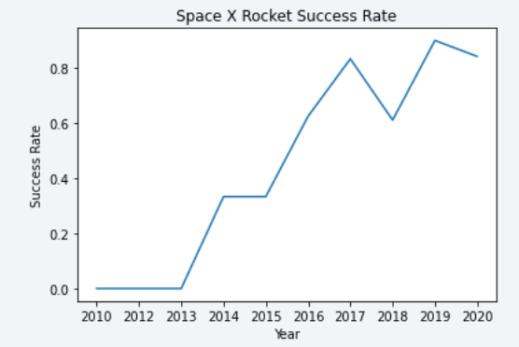
Launch Success Yearly Trend
We can see that there is an increase of success rate in Space X Rocket launches since 2013.

Slide 24
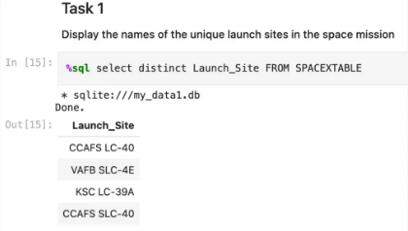
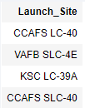
All Launch Site Names
Executed an SQL query to obtain all launch site names

Slide 25
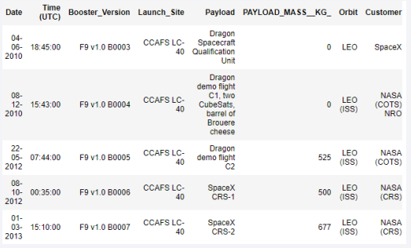
Launch Site Names Begin with 'CCA'
SQL query
Results
The WHERE clause followed by LIKE clause filters launch sites that contain the substring ‘CCA’

Slide 26
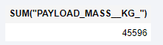
Total Payload Mass
SQL query
Results
The SQL query returns the sum of all payload masses where the customer is NASA (CRS).

Slide 27
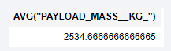
Average Payload Mass by F9 v1.1
SQL query
Results
The SQL query returns the average of all payload masses where the booster version contains substring F9 v1.1.

Slide 28
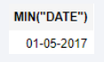
First Successful Ground Landing Date
SQL query
Results
This SQL query selects the oldest successful landing.
The WHERE clause filters dataset in order to only keep the records where landing was successful. With the MIN function, we select the record with the oldest date.

Slide 29
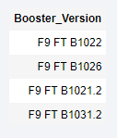
Successful Drone Ship Landing with Payload between 4000 and 6000
SQL query
Results
This SQL query returns the booster version where the landing was successful and the payload mass is between 4000 and 6000 kg. The WHERE and AND clause filter the dataset.

Slide 30
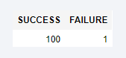
Total Number of Successful and Failure Mission Outcomes
SQL query
Results
The first SQL query SELECT shows the subqueries that return results. The first subquery counts the number of successful missions. The second subquery counts the number of unsuccessful missions. The WHERE clause followed by LIKE clause filters mission outcome. The COUNT functions counts the number of records that were filtered

Slide 31
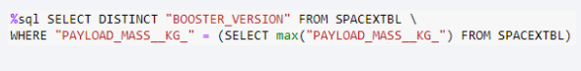
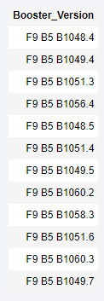
Boosters Carried Maximum Payload
SQL query
Results
This SQL subquery is to filter data by returning only the heaviest payload mass with MAX function. The main query uses subquery results and returns unique booster versions (SELECT DISTINCT) with the heaviest payload mass.

Slide 32
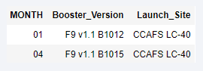
2015 Launch Records
SQL query
Results
This SQL query returns month, booster version, launch site where landing was unsuccessful and landing date in 2015.
Substr function processes the date in order to take month or year.

Slide 33
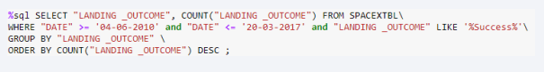
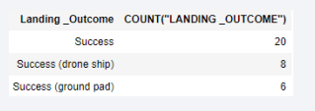
Rank Landing Outcomes Between 2010-06-04 and 2017-03-20
SQL query
Results
This SQL query returns landing outcomes and their count where mission was successful and the date is between 04/06/2010 and 20/03/2017. The GROUP BY clause groups results by landing outcome and ORDER BY COUNT DESC shows results in descending order.

Slide 34

Section 3

Slide 35
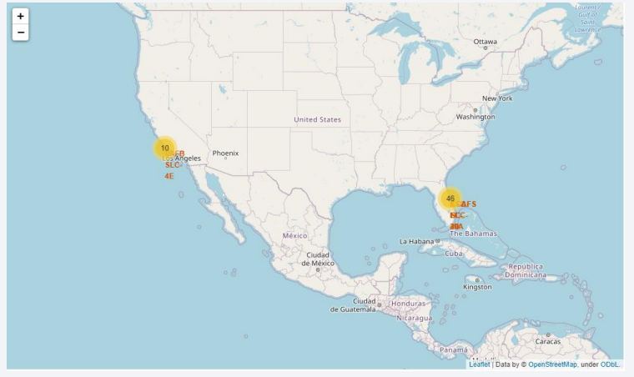
Folium map – launch sites
We can see that Space X launch sites are located on the coasts of the United States.

Slide 36
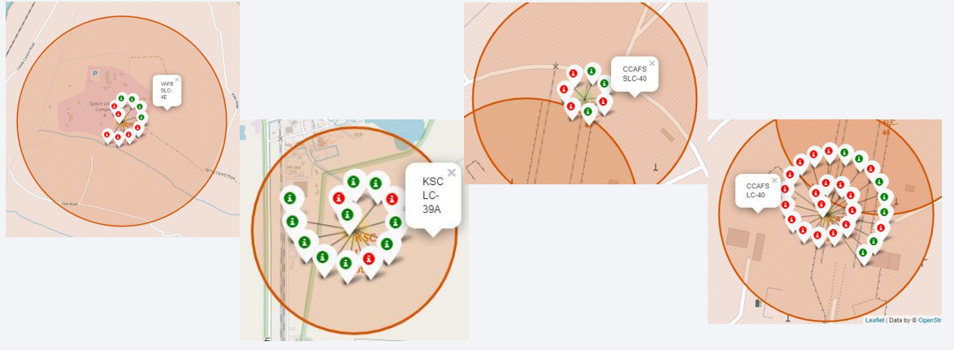
Folium map – Colour Labeled Markers
Green markers represents successful launches while Red markers represent unsuccessful launches.

Slide 37
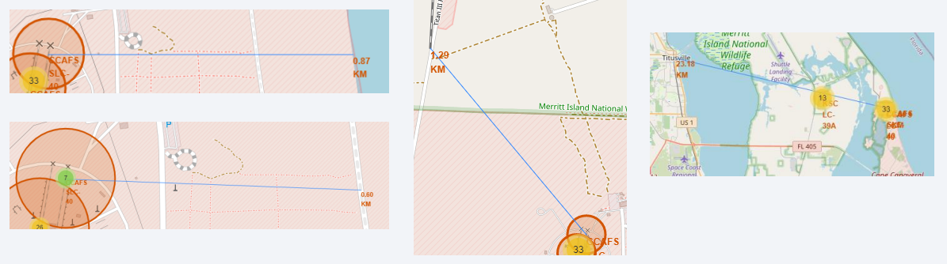
Folium map – Distances between CCAFS SLC-40 and its proximities
We can say that CCAFS SLC-40 is near railways, highways and coastline. It does not keep a certain distance away from cities.

Slide 38

Section 4

Slide 39
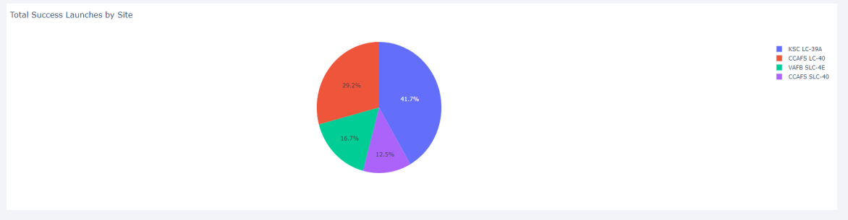
Dashboard – Success rates by launch sites
We can infer that KSC LC-39A has the best success rate of launches.

Slide 40
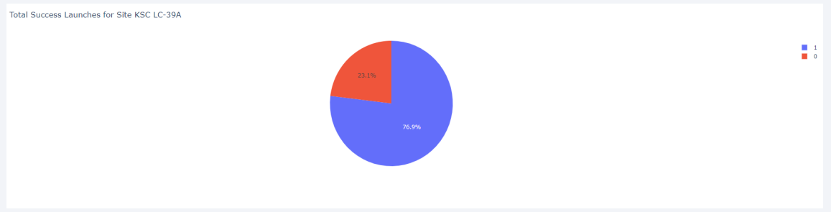
Dashboard – Success launches for Site KSC LC-39A
We can infer that KSC LC-39A has achieved a 76.9% success rate while getting a 23.1% failure rate

Slide 41
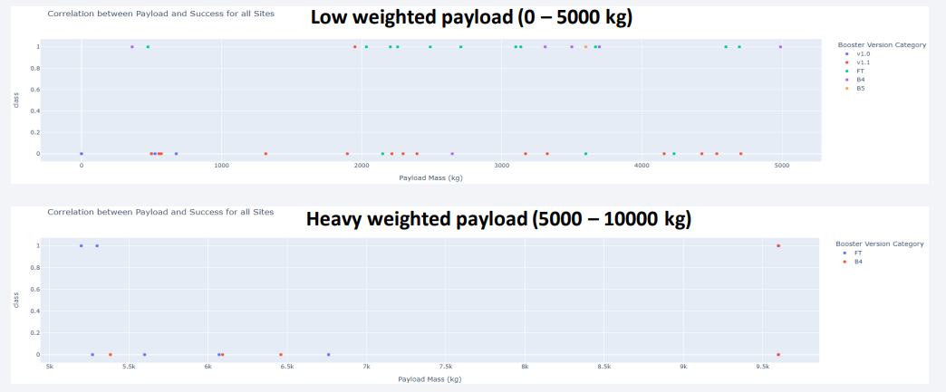
Dashboard – Payload mass vs Outcome for all sites with different payload mass
We can infer that low weighted payloads have a better success rate than the heavier payloads.

Slide 42

Section 5

Slide 43
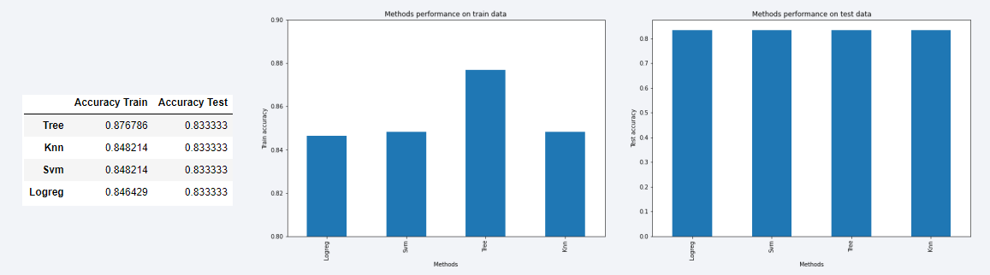
Classification Accuracy
For accuracy test, all the methods performed similarly. We could get more test data to decide between them. But if we really need to choose one right now, we would take the decision tree.
Decision tree best parameters

Slide 44
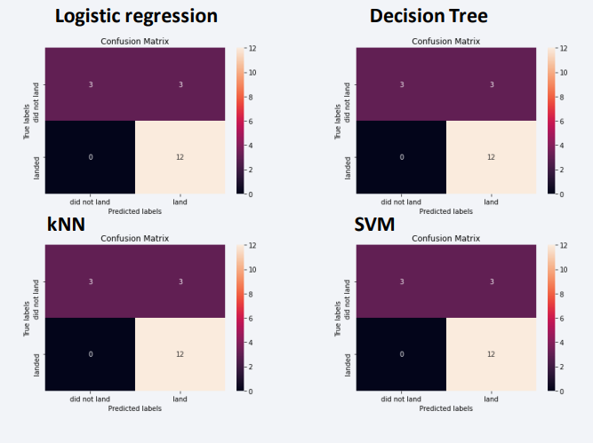
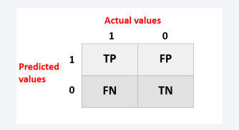
Confusion Matrix
As the test accuracy results are all equal, the confusion matrices are also identical. The main problem with these models are the false positives.

Slide 45
Conclusions
The success of a mission can be affected by several factors such as launch site, the orbit and particularly the number of previous launches. We can assume that there has been a gain in knowledge between the launches which resulted a launch failure turning into a success
GEO, HEO, SSO and ES-L1 orbits have the highest success rates
Depending on the orbits, the payload mass can be a criteria to take into account for the success of a mission. Certain orbits require a light or heavy payload mass. Generally, low weighted payloads perform better than heavy weighted payloads.
With the current data, there is no valid explanation on why certain launch sites are better than the others.
For this dataset, we choose the Decision Tree Algorithm as the best model.

Slide 46


